Slide 1
Entity Resolution with
Hierarchical Graph Attention Networks
Dezhong Yao; Yuhong Gu; Gao Cong; Hai Jin; Xinqiao Lv
SIGMOD 2022
朱浩嘉

Slide 2
提纲
问题背景
算法设计
实验分析
Notes:
我的汇报将围绕问题背景、算法设计、实验分析展开。

Slide 3
提纲
Entity Resolution(ER)
问题背景
Drawbacks of current ER methods

Slide 4
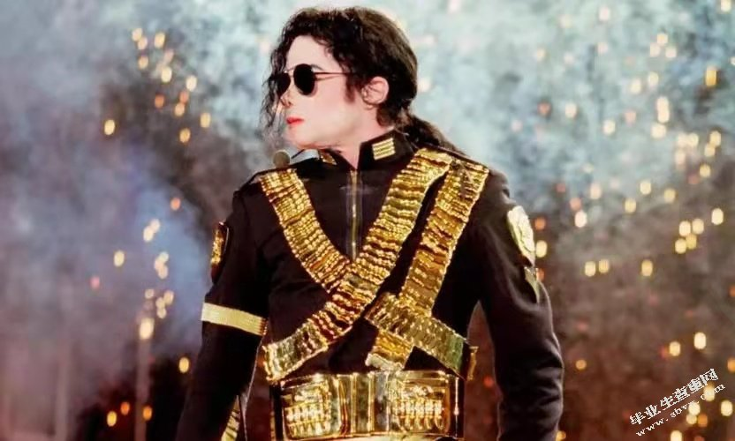
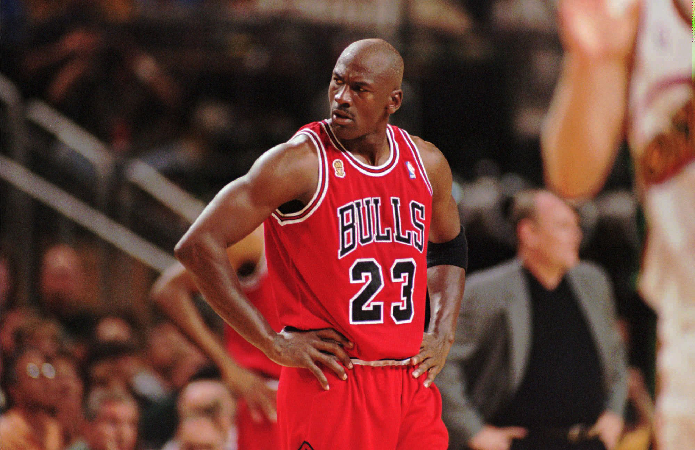
Entity Resolution
Definition: Entity resolution (ER) aims to find whether two data entities refer to the same entity
Data1(news):
Michael scored 50 points at the basketball game.
Data2(Wiki):
Michael Jackson
Michael Jordan
Notes:
各种数据都可以对齐 但这里数据是。。。

Slide 5
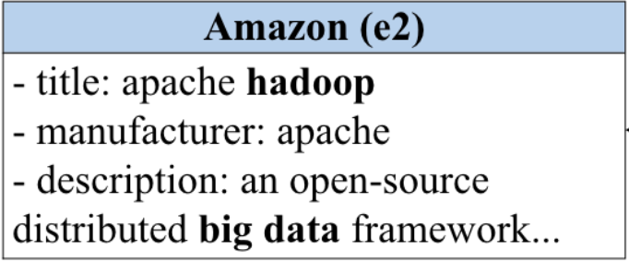
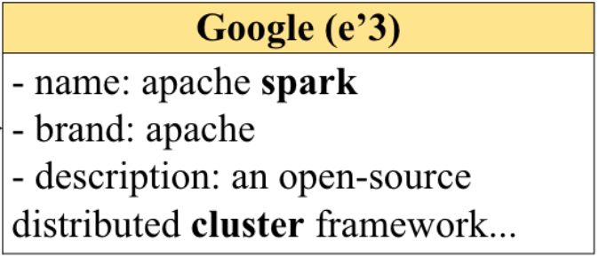
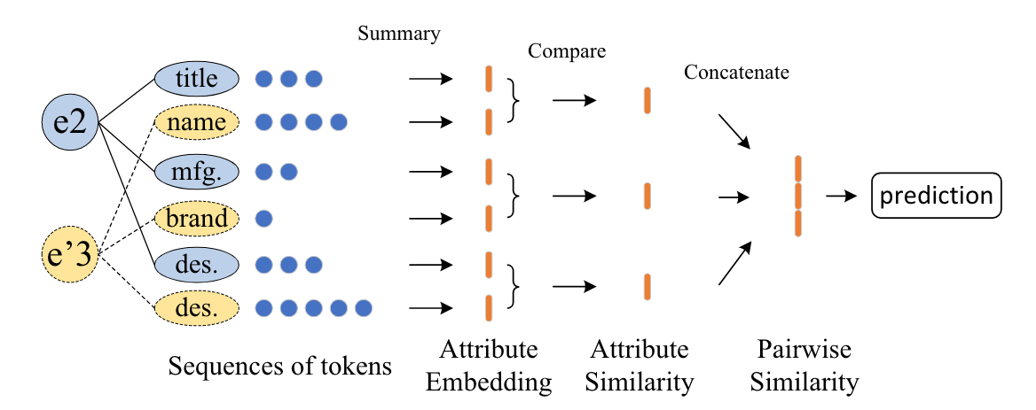
Entity Resolution
Entities are made of attributes:
Traditional ER:
Notes:
data长什么样
以前的方法概括来说把每个attribute的value编码成向量 向量之间看是否差得多

Slide 6
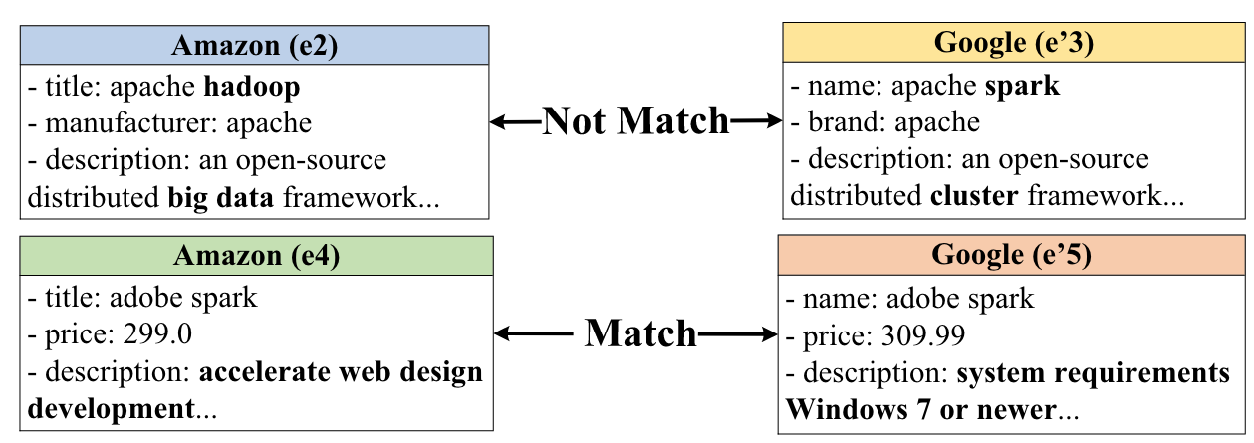
Drawbacks of current ER methods
Fails to identify the discriminative words and give the important words higher weight.
Entity descriptions often include ambiguous phrases.
Notes:
两个问题：
词没有权重
一词多义

Slide 7
Drawbacks of current ER methods
Drawbacks
Solution
Extend the graph neural network method and propose Hierarchical Heterogeneous Graph (HHG)
Adopt contextual embedding technique and propose Hierarchical Graph Attention Transformer model (HierGAT)
Fails to identify the discriminative words and give the important words higher weight.
Entity descriptions often include ambiguous phrases

Slide 8
提纲
HHG
算法设计
HierGAT

Slide 9
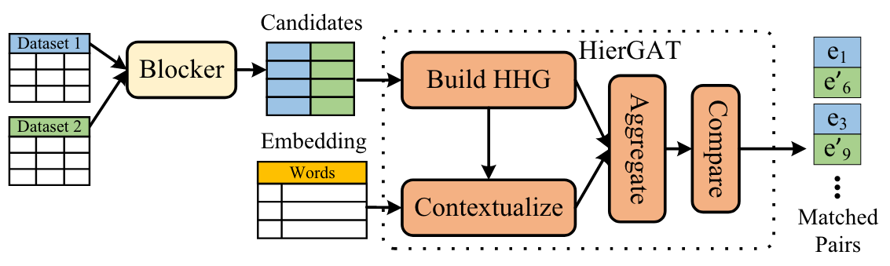
Overview
ER system architecture
Filter
prune obviously unmatching pairs
Classifier
determine match or not
Notes:
前半部分是过滤器 具体用blocker来去除掉不可能match的pair

Slide 10
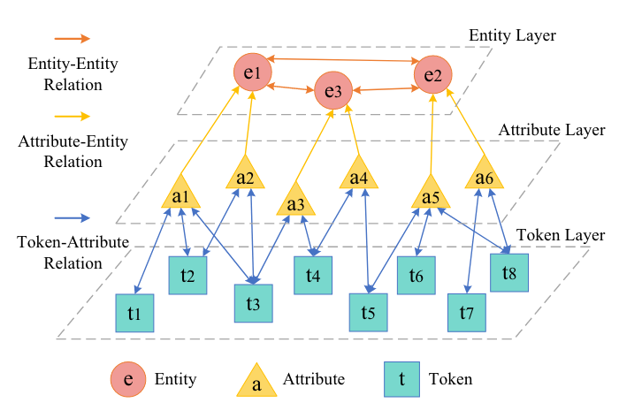
HHG
Advantages:
HHG preserves the hierarchical structure of an entity, and we can learn the entity embedding from bottom to top by following the hierarchy in the HHG.
Multiple candidate entities corresponding to a query entity can be represented in one graph.
Notes:
先大致通过下面的图介绍一下结构 然后讲好处 很多vector来表示
链接信息可以帮助学到更好地embedding
实体一对多

Slide 11
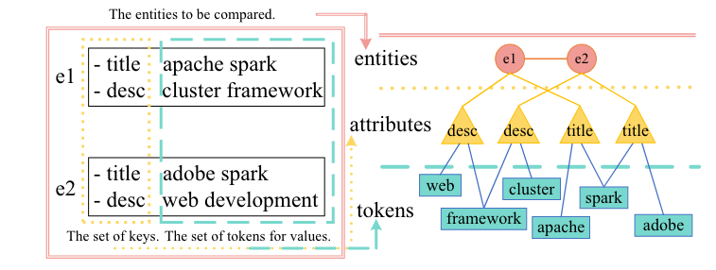
HHG
Construction of HHG
Each node in a HHG is represented by a semantic vector of the same length
How to calculate these vectors？
How to use HHG？
Notes:
更加具体的例子

Slide 12
HierGAT
Components of HierGAT
Contextual embedding: generate word+context (WpC) embeddings
Entity aggregation: aggregates WpC embeddings to derive entity embeddings based on HHG
Entity comparison: hierarchically compares the entities’ similarities to derive entity similarity embeddings
How each part works?
How to train?
Notes:
token的embeding
合成entitiy的embeding
对比

Slide 13
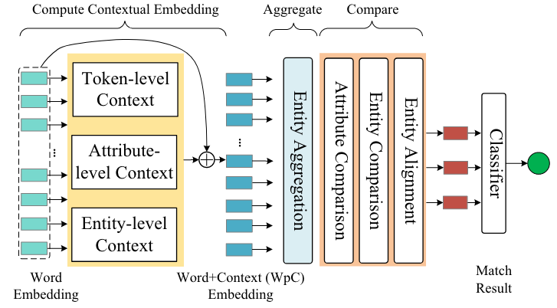
HierGAT
Components of HierGAT

Slide 14
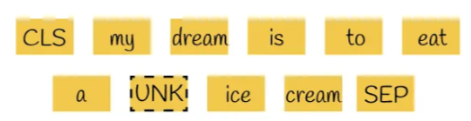
HierGAT
Contextual embedding
Challenges:
Unknown words are ignored, but they are very discriminating in the ER problem
The same word token in different attributes or different entities may have different contextual information
Notes:
已经有一些embeding方法

Slide 15
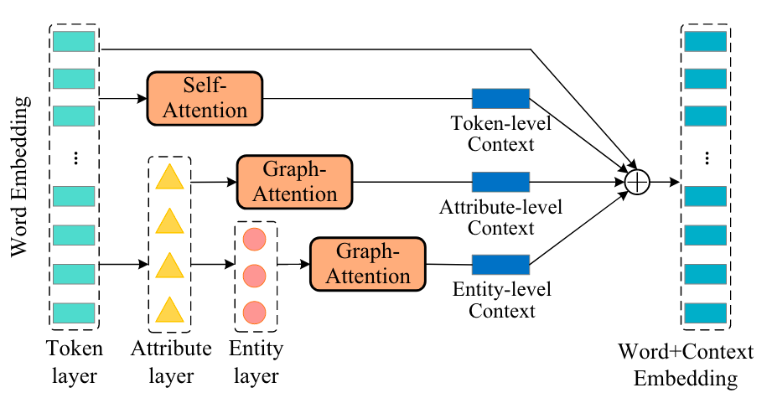
HierGAT
Contextual embedding
Solution:
Notes:
捕捉token不同级别的context

Slide 16







HierGAT
Token-Level Context Embedding:
Attribute-Level Context Embedding:
- Learning weight for each token from HHG
- Remove the redundant context from attributed context
Entity-Level Context Embedding:
Context Embedding:

Slide 17
HierGAT
Components of HierGAT

Slide 18
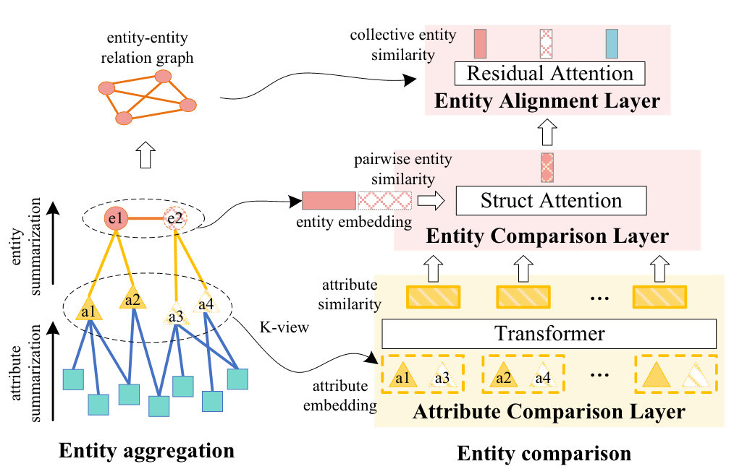
HierGAT
Entity aggregation
Notes:
自下而上的聚集

Slide 19

HierGAT
Entity aggregation
Drawbacks of previous method:
RNN network fails to incorporate the tokens’ importance and position information
Transformer-based approach fails to consider structural information of entities
Position embedding with info from HHG

Slide 20
HierGAT
Components of HierGAT

Slide 21
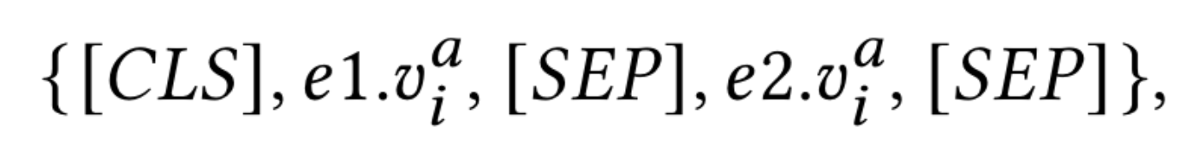
HierGAT
Entity comparison
Layers:
Attribute Comparison Layer: measure the similarity of the attributes of two entities with Transformer
Entity Comparison Layer: use multi-view learning to generate the similarity embedding of entities
Entity Alignment Layer: remove the redundant token embeddings from each entities with hard attention mechanism; compute the similarity embeddings of entity pairs
Notes:
用了别人的方法 Attribute Comparison Layer 把两个attribute的embeding拼接在一起过transformer
Entity Comparison Layer 可以把每个attribute直接拼起来给transformer 但这样就没有权重了 每个view有不同权重

Slide 22
HierGAT
Training process
Initialize the pre-trained LM and obtain word embedding. Construct the HHGs from the training set;
Compute contextual embeddings, and get WpC embeddings;
Obtain attribute embedding and entity embedding through hierarchical aggregation;
Compute attribute similarity embeddings and entity similarity embedding of two entities;
The final matching results are obtained using the classifier that takes similarity embedding as input
Use the cross-entropy function to calculate the classification loss
training of the HierGAT + the fine-tuning of the pre-trained LM

Slide 23
提纲
Datasets
Settings
实验分析
Baseline Models
Results

Slide 24
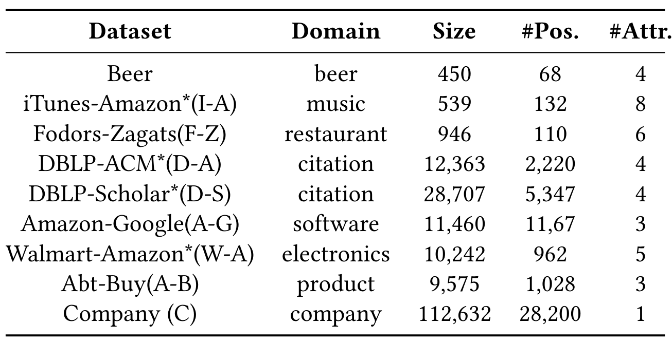
Datasets
Benchmark Datasets (after blocking)
Dirty Datasets
Mixed Datasets
Notes:
dirty attribute里面有随机加入的错误信息
benchmark就是对比
dirty测robust
mixed测multi-domain

Slide 25
Settings
learning rate: 1e-5
epochs: 10
parameter optimizer: Adam
Transformer sequence length: 512
batch size: 16, 4 for the iTunes-Amazon dataset
evaluation metrics: F1
Notes:
dirty attribute里面有随机加入的错误信息
benchmark就是对比
dirty测robust
mixed测multi-domain

Slide 26
Baseline Models
Magellan: decision tree, random forest, SVM, linear regression, and logistic regression
DeepMatcher (DM): GRU-RNN model
Ditto: Transformer
Notes:
dirty attribute里面有随机加入的错误信息
benchmark就是对比
dirty测robust
mixed测multi-domain

Slide 27
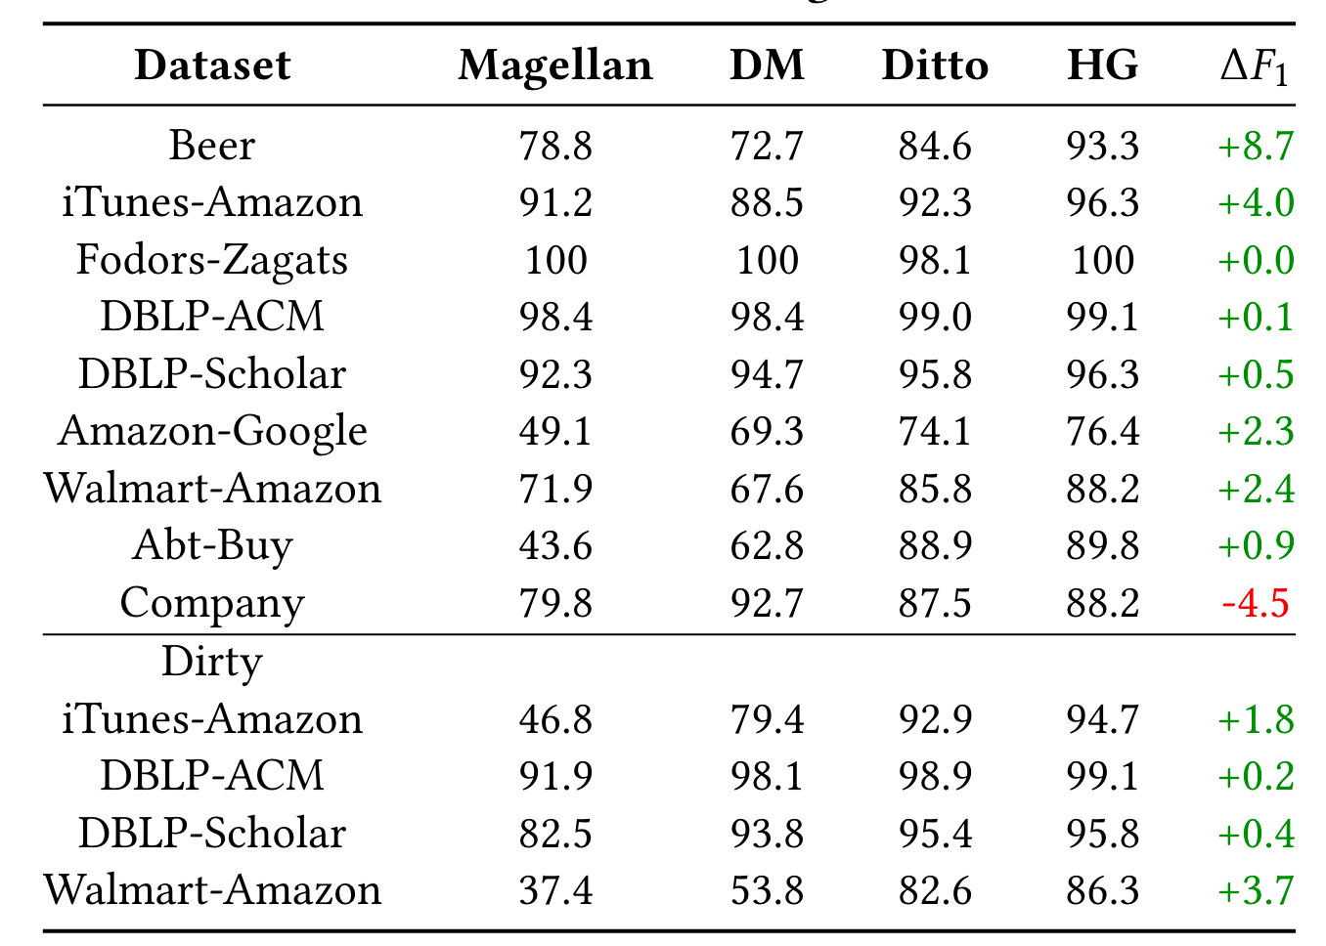
Results
F1 score improvement is up to 32.5% for DeepMatcher and 8.7% for Ditto
Notes:
dirty attribute里面有随机加入的错误信息
benchmark就是对比
dirty测robust
mixed测multi-domain

Slide 28
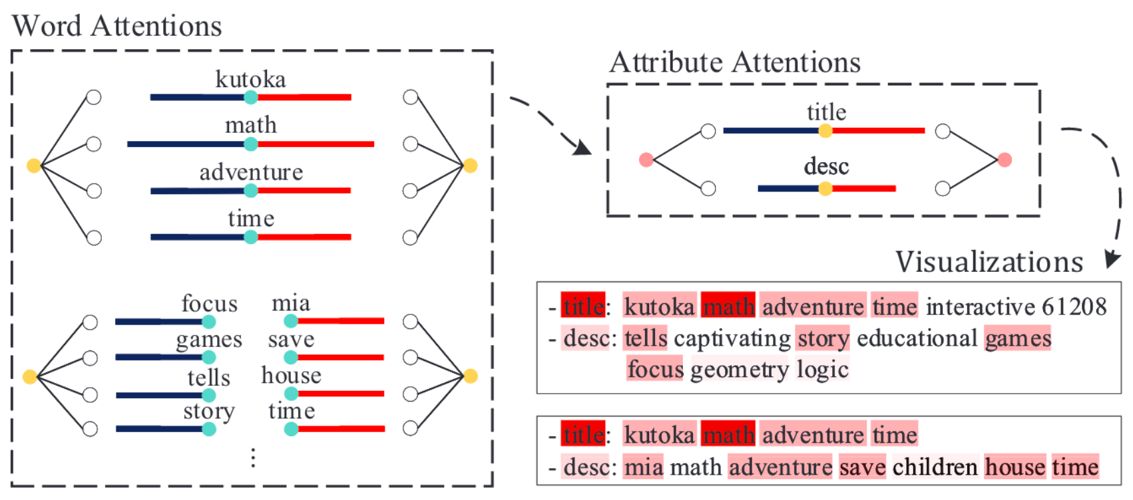
Results
HierGAT gives more importance to discriminating words and important attributes
Notes:
dirty attribute里面有随机加入的错误信息
benchmark就是对比
dirty测robust
mixed测multi-domain

Slide 29
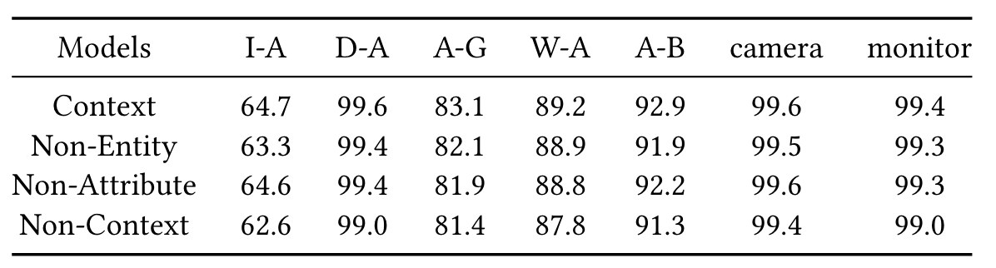
Results
𝐹1-score with vs without contextual information
Notes:
dirty attribute里面有随机加入的错误信息
benchmark就是对比
dirty测robust
mixed测multi-domain

Slide 30
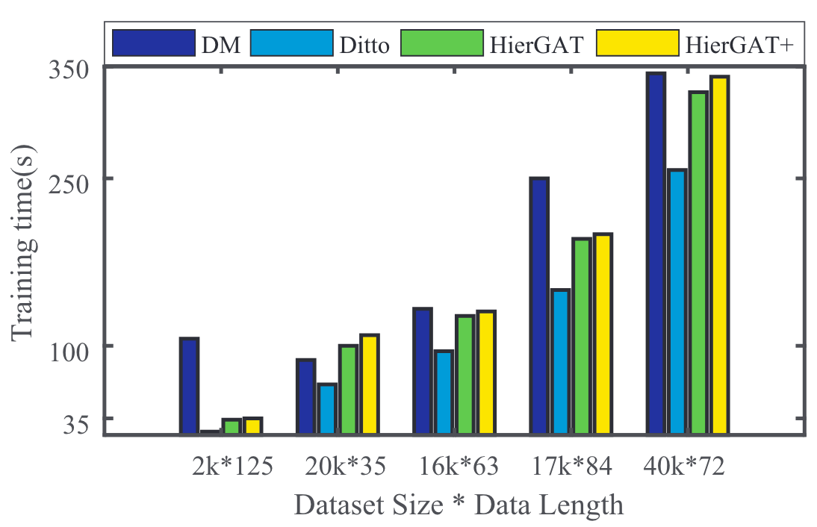
Results
Training time for the Megallan datasets
Notes:
dirty attribute里面有随机加入的错误信息
benchmark就是对比
dirty测robust
mixed测multi-domain

